Slide 1
Ap-FSM: A parallel algorithm for approximate frequent subgraph mining using Pregel
2018.6.25

Slide 2
Background
http://data-mining.philippe-fournier-viger.com/introduction-frequent-subgraph-mining/

Slide 3
Abstract
To make the task of subgraph mining less expensive computationally, approximate subgraph mining can be applied which will capture similar structure subgraphs as of exact subgraph mining.
In this paper, we propose an approximate subgraph mining algorithm named Ap-FSM implemented on distributed graph environment Pregel.
The working of Ap-FSM is divided into three phases.
The first phase selects the representative graph from the original graph while preserving the original graph properties. The second phase efficiently performs subgraph extension. Phase 3 introduces a novel two-step optimization for performing subgraph pruning.
Analyzing such large graph data will be beneficial from the perspective of expert and intelligent systems, as discovered patterns can be used for knowledge discovery and decision making.

Slide 4
Introduction
Representing data as graphs to understand the relationships among data objects is gaining high interest.
Getting the faster approximate results is significant than getting the exact results.
Analyzing large graph at small scale, while capturing the original graph properties is convenient and relatively easy task for analysis.
A number of existing research explored either distributed algorithms or sampling for handling large graph. But, both of the aforementioned approaches have been somewhat orthogonal till now.
In Ap-FSM, the shortcoming of either approach is compensated by the advantages of the other.

Slide 5
Related work
The summary of the characteristics of the proposed algorithm along with the existing algorithms are given in Table 1 .

Slide 6


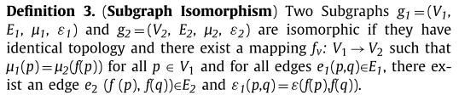
Preliminaries and background

Slide 7
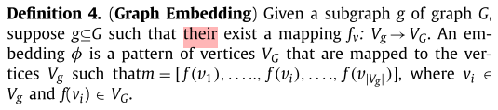
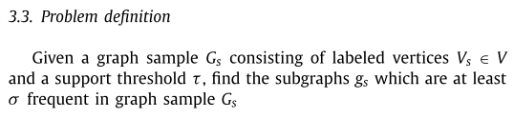
Preliminaries and background

Slide 8
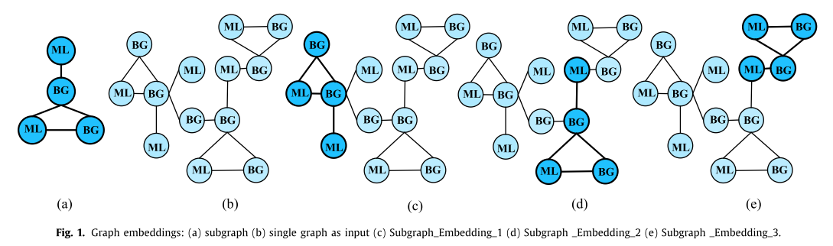
Preliminaries and background

Slide 9
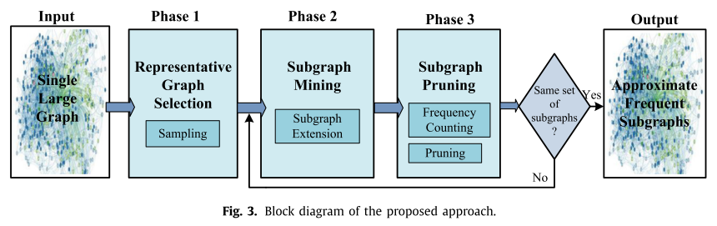
The proposed algorithm
Ap-FSM discovers representative approximate frequent subgraphs from a single massive graph.
Ap-FSM sums the frequency of every candidate subgraph and prunes those subgraphs which are not frequent.

Slide 10
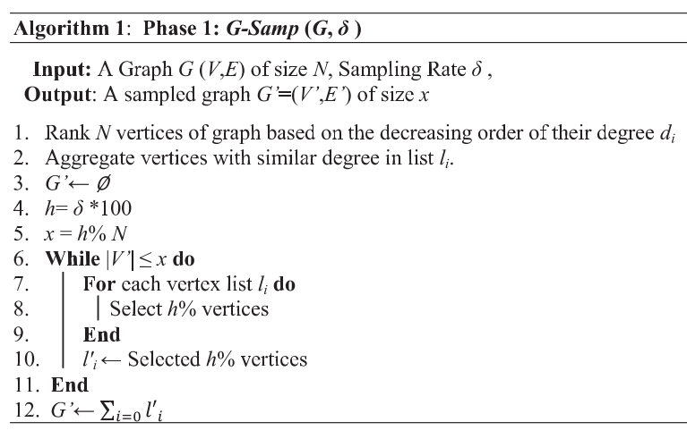
The proposed algorithm: representative graph selection
In this phase, the frequent subgraphs are identified in multiple iterations by performing one node and one edge extension in each iteration.

Slide 11
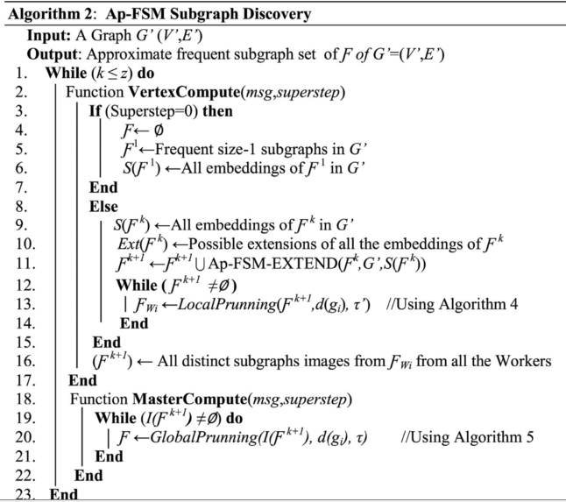
The proposed algorithm: subgraph extension

Slide 12
The proposed algorithm: subgraph extension
The multiple discovery of same vertex in depth-first tree rooted at that vertex should be avoided.
Ap-FSM eliminates such redundant calculations by allocating each vertex at level k , a unique parent vertex at level( k −1).

Slide 13
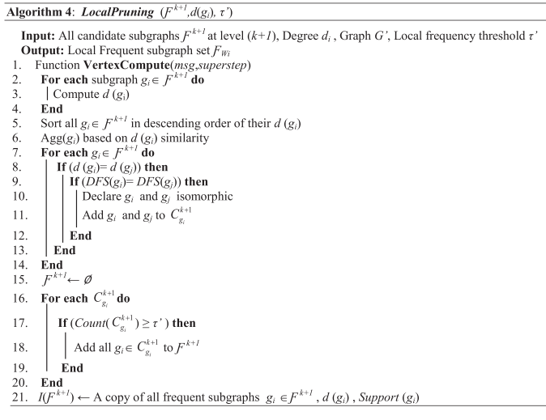
The proposed algorithm: subgraph pruning

Slide 14
The proposed algorithm: subgraph pruning
The candidate subgraphs having support lesser than the minimum support are discarded. Rest of the subgraphs are added to the list of frequent subgraphs.
The computation of subgraph pruning in proposed Ap-FSM are performed in two steps in each iteration at local level on each Worker node and then on globally on Master node.
Detecting isomorphism is computationally expensive and is NP Complete.

Slide 15
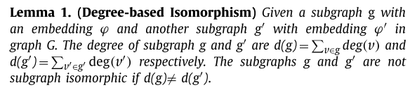

The proposed algorithm: subgraph pruning
Using Lemma 1 , two non-isomorphic subgraphs can be identified, but the subgraph isomorphism cannot be confirmed
The minimum DFS code is a sequence of labels of vertices and edges( Yan & Han, 2002 ).

Slide 16
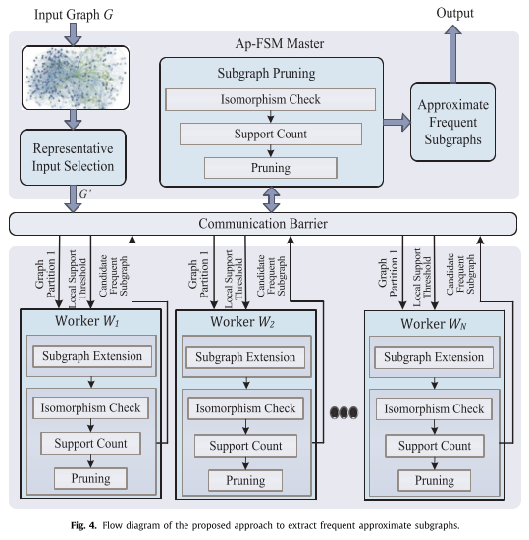
The proposed algorithm

Slide 17
Performance evaluation
Degree similarity, Clustering coefficient, Betweenness similarity
Comparison with existing approaches
Scalability and speedup
Evaluation of optimizations
Accuracy

Slide 18
THANK YOU

